Slide 1
Guide to Computer Forensics and Investigations
Fourth Edition
Chapter 3
The Investigator’s Office and Laboratory

Slide 2
Objectives
Describe certification requirements for computer forensics labs
List physical requirements for a computer forensics lab
Explain the criteria for selecting a basic forensic workstation
Describe components used to build a business case for developing a forensics lab

Slide 3
Understanding Forensics Lab Certification Requirements

Slide 4
Understanding Forensics Lab Certification Requirements
Computer forensics lab
  Where you conduct your investigation
  Store evidence
  House your equipment, hardware, and software
American Society of Crime Laboratory Directors (ASCLD) offers guidelines for:
  Managing a lab
  Acquiring an official certification
  Auditing lab functions and procedures

Slide 5
Identifying Duties of the Lab Manager and Staff
Lab manager duties:
  Set up processes for managing cases
  Promote group consensus in decision making
  Maintain fiscal responsibility for lab needs
  Enforce ethical standards among lab staff members
  Plan updates for the lab
  Establish and promote quality-assurance processes
  Set reasonable production schedules
  Estimate how many cases an investigator can handle

Slide 6
Identifying Duties of the Lab Manager and Staff (continued)
Lab manager duties (continued):
  Estimate when to expect preliminary and final results
  Create and monitor lab policies for staff
  Provide a safe and secure workplace for staff and evidence
Staff member duties:
  Knowledge and training:
    Hardware and software
    OS and file types
    Deductive reasoning

Slide 7
Identifying Duties of the Lab Manager and Staff (continued)
Staff member duties (continued):
  Knowledge and training (continued):
    Technical training
    Investigative skills
    Deductive reasoning
  Work is reviewed regularly by the lab manager
Check the ASCLD Web site for online manual and information (but it's not free, as far as I can tell)

Slide 8
Lab Budget Planning
Break costs down into daily, quarterly, and annual expenses
Use past investigation expenses to extrapolate expected future costs
Expenses for a lab include:
  Hardware
  Software
  Facility space
  Trained personnel

Slide 9
Lab Budget Planning (continued)
Estimate the number of computer cases your lab expects to examine
  Identify types of computers you’re likely to examine
Take into account changes in technology
Use statistics to determine what kind of computer crimes are more likely to occur
Use this information to plan ahead your lab requirements and costs

Slide 10
Lab Budget Planning (continued)
Check statistics from the Uniform Crime Report
  For federal reports, see www.fbi.gov/ucr/ucr.htm
Identify crimes committed with specialized software
When setting up a lab for a private company, check:
  Hardware and software inventory
  Problems reported last year
  Future developments in computing technology
Time management is a major issue when choosing software and hardware to purchase

Slide 11
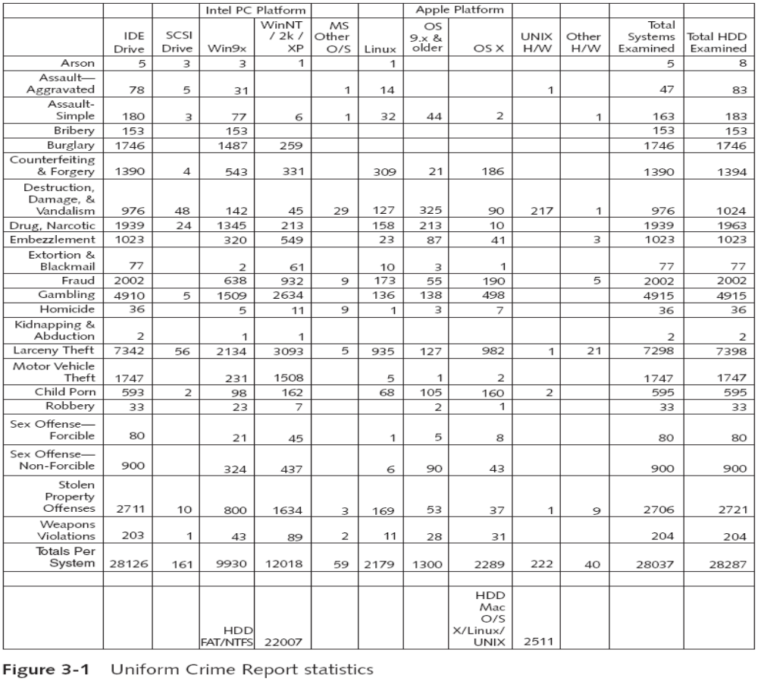
Lab Budget Planning (continued)

Slide 12
Acquiring Certification and Training
Update your skills through appropriate training
International Association of Computer Investigative Specialists (IACIS)
  Created by police officers who wanted to formalize credentials in computing investigations
  Only open to law enforcement officers or full-time civilian employees of law enforcement agencies
  Certified Electronic Evidence Collection Specialist (CEECS)
  Certified Forensic Computer Examiners (CFCEs)

Slide 13
Acquiring Certification and Training (continued)
High-Tech Crime Network (HTCN)
  Certified Computer Crime Investigator, Basic and Advanced Level
    Basic requires 3 years of experience and 10 cases
  Certified Computer Forensic Technician, Basic and Advanced Level

Slide 14
Acquiring Certification and Training (continued)
Certifications that are available without police experience
EnCase Certified Examiner (EnCE) Certification
  Link Ch 3d
AccessData Certified Examiner (ACE) Certification
  Link Ch 3e
Other Training and Certifications
  High Technology Crime Investigation Association (HTCIA)

Slide 15
Acquiring Certification and Training (continued)
Other training and certifications
  SysAdmin, Audit, Network, Security (SANS) Institute
  Computer Technology Investigators Network (CTIN)
  NewTechnologies, Inc. (NTI)
  Southeast Cybercrime Institute at Kennesaw State University
  Federal Law Enforcement Training Center (FLETC)
  National White Collar Crime Center (NW3C)

Slide 16
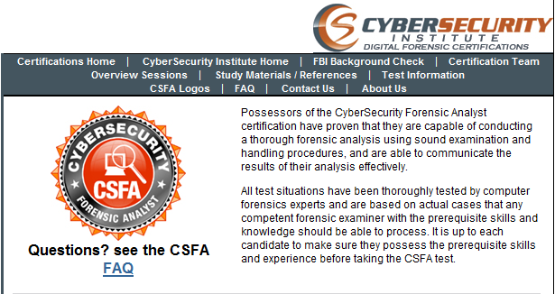
CyberSecurity Forensic Analyst (CSFA)
Steve Hailey's company in Washington State
70% of grade based on practical exam
Three days to complete a case
  Link Ch 3f

Slide 17
Recommended Certifications
First get ACE Certification
Then get CSFA
We expect a local opportunity to get the CSFA within the next few months
Doug Spindler from PacITPros is working on it
  pacitpros.org
  Meetings on the first Tuesday each month
  Extra credit for attending

Slide 18
Determining the Physical Requirements for a Computer Forensics Lab

Slide 19
Determining the Physical Requirements for a Computer Forensics Lab
Most of your investigation is conducted in a lab
Lab should be secure so evidence is not lost, corrupted, or destroyed
Provide a safe and secure physical environment
Keep inventory control of your assets
  Know when to order more supplies

Slide 20
Identifying Lab Security Needs
Secure facility
  Should preserve integrity of evidence data
Minimum requirements
  Small room with true floor-to-ceiling walls
  Door access with a locking mechanism
  Secure container
  Visitor’s log
People working together should have same access level
Brief your staff about security policy

Slide 21
Conducting High-Risk Investigations
High-risk investigations (national security or murder) demand more security to prevent computer eavesdropping
  TEMPEST facilities
    Electromagnetic Radiation (EMR) proofed
    http://nsi.org/Library/Govt/Nispom.html
  TEMPEST facilities are very expensive
    You can use low-emanation workstations instead

Slide 22
Using Evidence Containers
Known as evidence lockers
  Must be secure so that no unauthorized person can easily access your evidence
Recommendations for securing storage containers:
  Locate them in a restricted area
  Limited number of authorized people to access the container
  Maintain records on who is authorized to access each container
  Containers should remain locked when not in use

Slide 23
Using Evidence Containers (continued)
If a combination locking system is used:
  Provide the same level of security for the combination as for the container’s contents
  Destroy any previous combinations after setting up a new combination
  Allow only authorized personnel to change lock combinations
  Change the combination every six months or when required

Slide 24
Using Evidence Containers (continued)
If you’re using a keyed padlock:
  Appoint a key custodian
  Stamp sequential numbers on each duplicate key
  Maintain a registry listing which key is assigned to which authorized person
  Conduct a monthly audit
  Take an inventory of all keys
  Place keys in a lockable container
  Maintain the same level of security for keys as for evidence containers
  Change locks and keys annually
  Don't use a master key for several locks

Slide 25
Using Evidence Containers (continued)
Container should be made of steel with an internal cabinet or external padlock
If possible, acquire a media safe
  Protects evidence from fire damage
When possible, build an evidence storage room in your lab
Keep an evidence log
  Update it every time an evidence container is opened and closed

Slide 26
Overseeing Facility Maintenance
Immediately repair physical damages
Escort cleaning crews as they work
Minimize the risk of static electricity
  Antistatic pads
  Clean floor and carpets
Maintain two separate trash containers
  Materials unrelated to an investigation
  Sensitive materials
When possible, hire specialized companies for disposing sensitive materials

Slide 27
Considering Physical Security Needs
Create a security policy
Enforce your policy
  Sign-in log for visitors
    Anyone that is not assigned to the lab is a visitor
    Escort all visitors all the time
  Use visible or audible indicators that a visitor is inside your premises
    Visitor badge
  Install an intrusion alarm system
  Hire a guard force for your lab

Slide 28
Auditing a Computer Forensics Lab
Auditing ensures proper enforcing of policies
Audits should include inspecting:
  Ceiling, floor, roof, and exterior walls of the lab
  Doors and doors locks
  Visitor logs
  Evidence container logs
  At the end of every workday, secure any evidence that’s not being processed in a forensic workstation

Slide 29
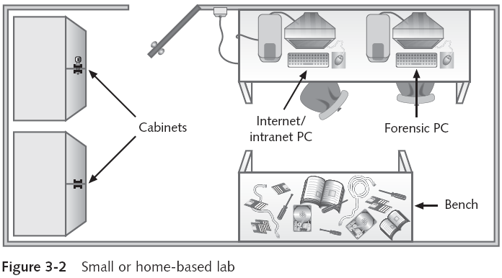
Determining Floor Plans for Computer Forensics Labs

Slide 30
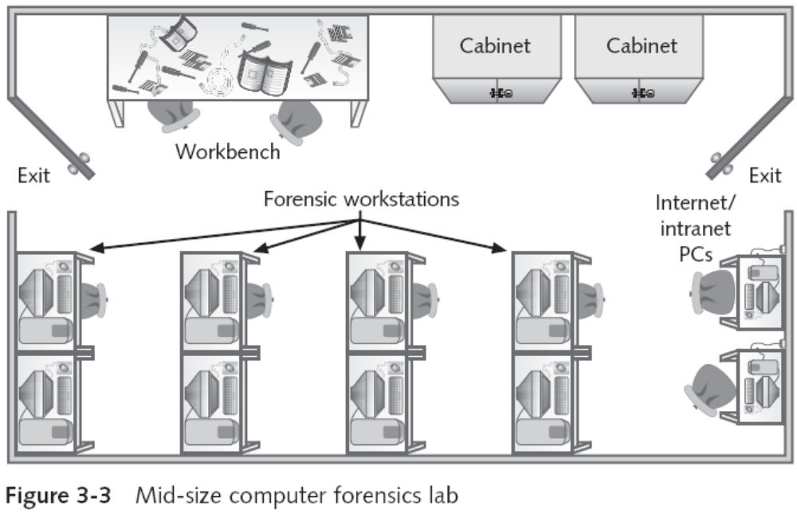
Determining Floor Plans for Computer Forensics Labs (continued)

Slide 31
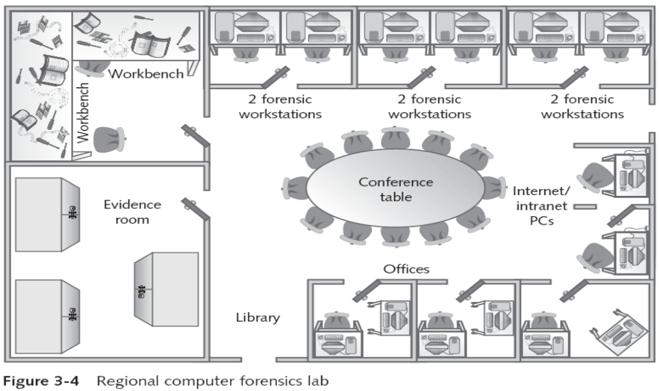
Determining Floor Plans for Computer Forensics Labs (continued)

Slide 32
Selecting a Basic Forensic Workstation

Slide 33
Selecting a Basic Forensic Workstation
Depends on budget and needs
Use less powerful workstations for mundane tasks
Use multipurpose workstations for high-end analysis tasks

Slide 34
Selecting Workstations for Police Labs
Police labs have the most diverse needs for computing investigation tools
  Special-interest groups (SIG) are helpful to investigate old systems, like CP/M, Commodore 64, etc.
General rule
  One computer investigator for every 250,000 people in a region
  One multipurpose forensic workstation and one general-purpose workstation

Slide 35
Selecting Workstations for Private and Corporate Labs
Requirements are easy to determine, because you can specialize
Identify the environment you deal with
  Hardware platform
  Operating system
Gather tools to work on the specified environment

Slide 36
Stocking Hardware Peripherals
Any lab should have in stock:
  IDE cables
  Ribbon cables for floppy disks
  SCSI cards, preferably ultra-wide
  Graphics cards, both PCI and AGP types
  Power cords
  Hard disk drives
  At least two 2.5-inch Notebook IDE hard drives to standard IDE/ATA or SATA adapter
  Computer hand tools

Slide 37
Maintaining Operating Systems and Software Inventories
Maintain licensed copies of software like:
  Microsoft Office 2007, XP, 2003, 2000, 97, and 95
  Quicken
  Programming languages
  Specialized viewers
  Corel Office Suite
  StarOffice/OpenOffice
  Peachtree accounting applications

Slide 38
Using a Disaster Recovery Plan
Keep regular backups, using Ghost or other utilities
  Win 7 has Windows Image Backup
Store backups off-site but securely
Be able to restore your workstation and investigation files to their original condition
  Recover from catastrophic situations, virus contamination, and reconfigurations
Configuration management
  Keep track of software updates to your workstation

Slide 39
Planning for Equipment Upgrades
Risk management
  Involves determining how much risk is acceptable for any process or operation
  Identify equipment your lab depends on so it can be periodically replaced
  Identify equipment you can replace when it fails
Computing components last 18 to 36 months under normal conditions
  Schedule upgrades at least every 18 months
    Preferably every 12 months

Slide 40
Using Laptop Forensic Workstations
Create a lightweight, mobile forensic workstation using a laptop PC
  FireWire port
  USB 2.0 port
  PCMCIA SATA hard disk
Laptops are still limited as forensic workstations
  But improving

Slide 41
Building a Business Case for Developing a Forensics Lab

Slide 42
Building a Business Case for Developing a Forensics Lab
Can be a problem because of budget problems
Business case
  Plan you can use to sell your services to management or clients
Demonstrate how the lab will help your organization to save money and increase profits
  Compare cost of an investigation with cost of a lawsuit
  Protect intellectual property, trade secrets, and future business plans

Slide 43
Preparing a Business Case for a Computer Forensics Lab
When preparing your case, follow these steps:
  Justification
  Budget development
    Facility cost
    Computer hardware requirements
    Software requirements
    Miscellaneous costs
      Errors and Omissions Insurance!
  Approval and acquisition
  Implementation

Slide 44
Preparing a Business Case for a Computer Forensics Lab (continued)
Steps:
  Acceptance testing
  Correction for acceptance
  Production

